Slide 1
.NET/C# Training
Parthiban
05/11/2023
Notes:
This template can be used as a starter file for presenting training materials in a group setting.
Sections
Right-click on a slide to add sections. Sections can help to organize your slides or facilitate collaboration between multiple authors.
Notes
Use the Notes section for delivery notes or to provide additional details for the audience. View these notes in Presentation View during your presentation.
Keep in mind the font size (important for accessibility, visibility, videotaping, and online production)
Coordinated colors
Pay particular attention to the graphs, charts, and text boxes.
Consider that attendees will print in black and white or grayscale. Run a test print to make sure your colors work when printed in pure black and white and grayscale.
Graphics, tables, and graphs
Keep it simple: If possible, use consistent, non-distracting styles and colors.
Label all graphs and tables.

Slide 2
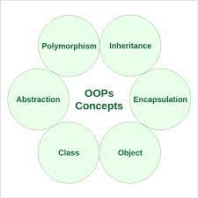
OOPS C#
Notes:
Give a brief overview of the presentation. Describe the major focus of the presentation and why it is important.
Introduce each of the major topics.
To provide a road map for the audience, you can repeat this Overview slide throughout the presentation, highlighting the particular topic you will discuss next.

Slide 3
Classes and Objects
Application
Application1
Data Filled+
Application1
Application2
Data Filled +Application2
Application3
Data Filled +Application3
Application…N
Data Filled+
Application N

Slide 4
Application1
Application1
Application
Application1
Application1
Application1
Application1
Application N
Data Filled
Object + Data Filled
Class
Object
Object1
Object2
Object3
:
:
Object N

Slide 5
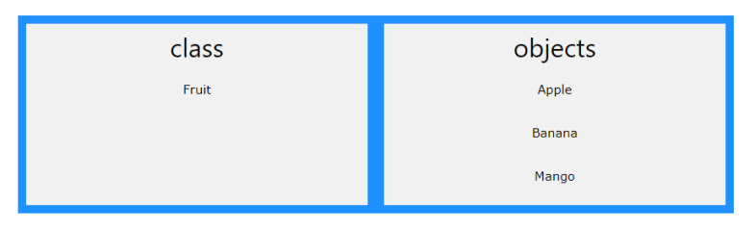
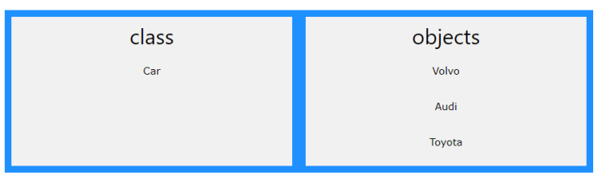
class is a template for objects, and an object is an instance of a class.

Slide 6
Constructors
class Test
{
public Test()
{
// This is the constructor method.
}
// rest of the class members goes here.
}
A constructor is a special method that is used to initialize objects.
The advantage of a constructor, is that it is called when an object of a class is created.
It can be used to set initial values for fields

Slide 7
Constructors
Default Constructors
Parameterized
Constructors
A constructor which has no argument is known as default constructor.
It is invoked at the time of creating object.
A constructor which has parameters is called parameterized constructor.
It is used to provide different values to distinct objects.

Slide 8
// Create a Car class
class Car
{
public string model; // Create a field
// Create a class constructor for the Car class
public Car()
{
model = "Mustang"; // Set the initial value for model
}
static void Main(string[] args)
{
Car Ford = new Car(); // Create an object of the Car Class (this will call the constructor)
Console.WriteLine(Ford.model); // Print the value of model
}
}
// Outputs "Mustang"

Slide 9
class Car
{
string color = "red";
}
class Car
{
string color = "red";
static void Main(string[] args)
{
Car myObj = new Car();
Console.WriteLine(myObj.color);
}
}

Slide 10
IF Statement
if (condition)
{
// block of code to be executed if the condition is True
}
else
{
// block of code to be executed if the condition is False
}
int time = 20;
if (time < 18)
{
Console.WriteLine("Good day.");
}
else
{
Console.WriteLine("Good evening.");
}
// Outputs "Good evening."
Notes:
Give a brief overview of the presentation. Describe the major focus of the presentation and why it is important.
Introduce each of the major topics.
To provide a road map for the audience, you can repeat this Overview slide throughout the presentation, highlighting the particular topic you will discuss next.

Slide 11
class Car
{
public string model;
// Create a class constructor with a parameter
public Car(string modelName)
{
model = modelName;
}
static void Main(string[] args)
{
Car Ford = new Car("Mustang");
Console.WriteLine(Ford.model);
}
}
// Outputs "Mustang"

Slide 12
class Car
{
public string model;
public string color;
public int year;
// Create a class constructor with multiple parameters
public Car(string modelName, string modelColor, int modelYear)
{
model = modelName;
color = modelColor;
year = modelYear;
}
static void Main(string[] args)
{
Car Ford = new Car("Mustang", "Red", 1969);
Console.WriteLine(Ford.color + " " + Ford.year + " " + Ford.model);
}
}
// Outputs Red 1969 Mustang

Slide 13
class Program
{
static void Main(string[] args)
{
Car Ford = new Car();
Ford.model = "Mustang";
Ford.color = "red";
Ford.year = 1969;
Car Opel = new Car();
Opel.model = "Astra";
Opel.color = "white";
Opel.year = 2005;
class Program
{
static void Main(string[] args)
{
Car Ford = new Car("Mustang", "Red", 1969);
Car Opel = new Car("Astra", "White", 2005);
Console.WriteLine(Ford.model);
Console.WriteLine(Opel.model);
}
}

Slide 14
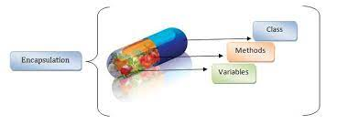
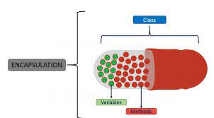
Encapsulation

Slide 15
make sure that "sensitive" data is hidden from users.
class Person
{
public string Name // property
{ get; set; }
}

Slide 16
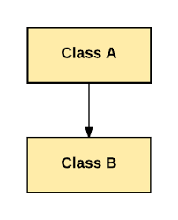
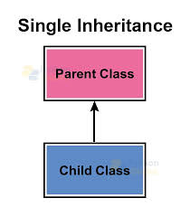
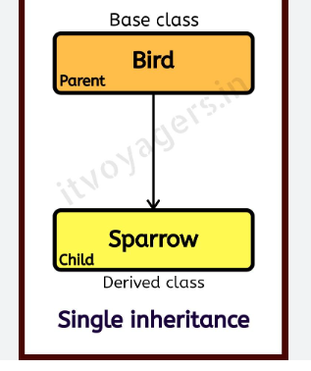
Inheritance

Slide 17
<acess-specifier> class <base_class>
{
...
}
class <derived_class> : <base_class>
{
...
}

Slide 18
Class A:
MethodA();
Class B:
MethodB();
Class A obj= new ClassA()
obj.MethodA()
Class B obj= new ClassB()
obj.MethodB()
);

Slide 19
Base Class
Derived Class
Class A:
MethodA();
Class B:
MethodB();
Inherits
Class A obj= new ClassA()
obj.MethodA()
Class B obj= new ClassB();
obj.MethodB();
obj.MethodA();

Slide 20
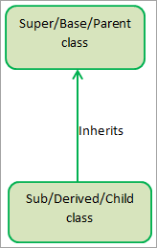
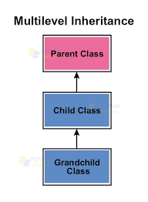
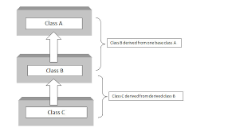
class Animal {
public void Eat() {
Console.WriteLine("Animal is eating.");
}
}
class Dog : Animal {
public void Bark() {
Console.WriteLine("Dog is barking.");
}
}

Slide 21
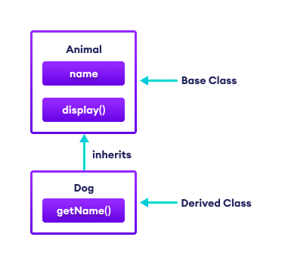
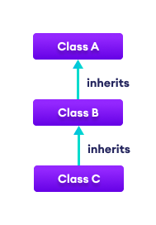
1. Single Inheritance
2. Multilevel Inheritance
Class B:A
Dog:Animal
Class C:B

Slide 22
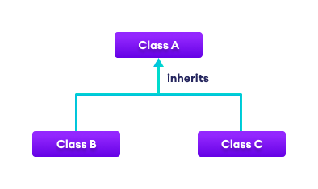
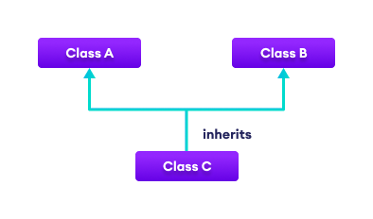
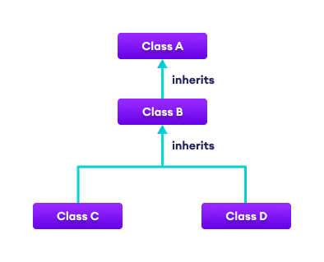
3. Hierarchical Inheritance
4. Multiple Inheritance
Class B:A
5. Hybrid Inheritance
Class C:A

Slide 23
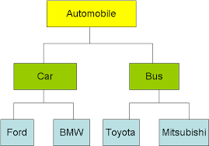

Slide 24
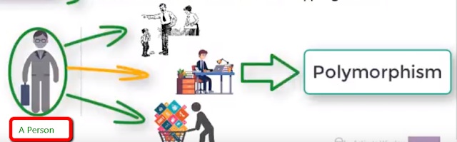
Polymorphism
It is used to one object behaving as multiple forms
polymorphism means one name many forms.

Slide 25
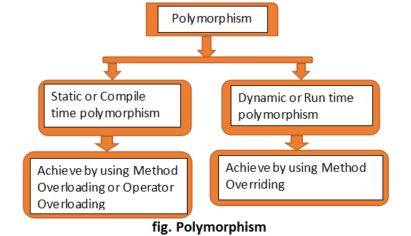

Slide 26
class Program
{
// Method Overloading
public int Add(int x, int y)
{
return x + y;
}
public int Add(int x, int y, int z)
{
return x + y + z;
}
static void Main(string[] args)
{
Program prog = new Program();
Console.WriteLine("Addition of Number is {0}", prog.Add(10, 20));
Console.WriteLine("Addition of Number is {0}", prog.Add(10, 20, 30));
Console.ReadLine();
}
}

Slide 27
using System;
namespace MethodOverriding
{
public class Employee
{
public virtual void PrintName(string fname, string lname)
{
Console.WriteLine("Full Name {0}", fname + " " + lname);
}
}
public class Child : Employee
{
public override void PrintName(string fname, string lname)
{
Console.WriteLine("Employee Full Name {0}", fname + " " + lname);
}
}

Slide 28
public class MethodOverridingDemo
{
static void Main(string[] args)
{
Employee emp;
emp = new Child();
emp.PrintName("Shri", "VT");
emp = new Employee();
emp.PrintName("Shrimant", "VT");
Console.ReadLine();
}
}
}

